Slide 1
Declarative Process Mining meets Industry. The Declare4Py Case
Fabrizio Maria Maggi ¹, Ivan Donadello ¹, Francesco Riva ^{1,2}
¹ Free University of Bozen-Bolzano, Bolzano, Italy
² DataLane SRL, Verona, Italy
ICPM 2023 conference
ML4PM workshop session
Rome, Italy – 23rd October 2023

Slide 2
Outline
01
Introduction to Declarative Process Mining
Speaker: Maggi
02
DataLane interest in Declarative PM
Speaker: Riva
03
Declare4Py overview
Speaker: Donadello
04
Declare4Py in action
Speaker: Donadello
05
Q&A session
Notes:
I’ll first show you a brief overview on Process Mining approaches. Then I’ll present the original contribution of the work.

Slide 3
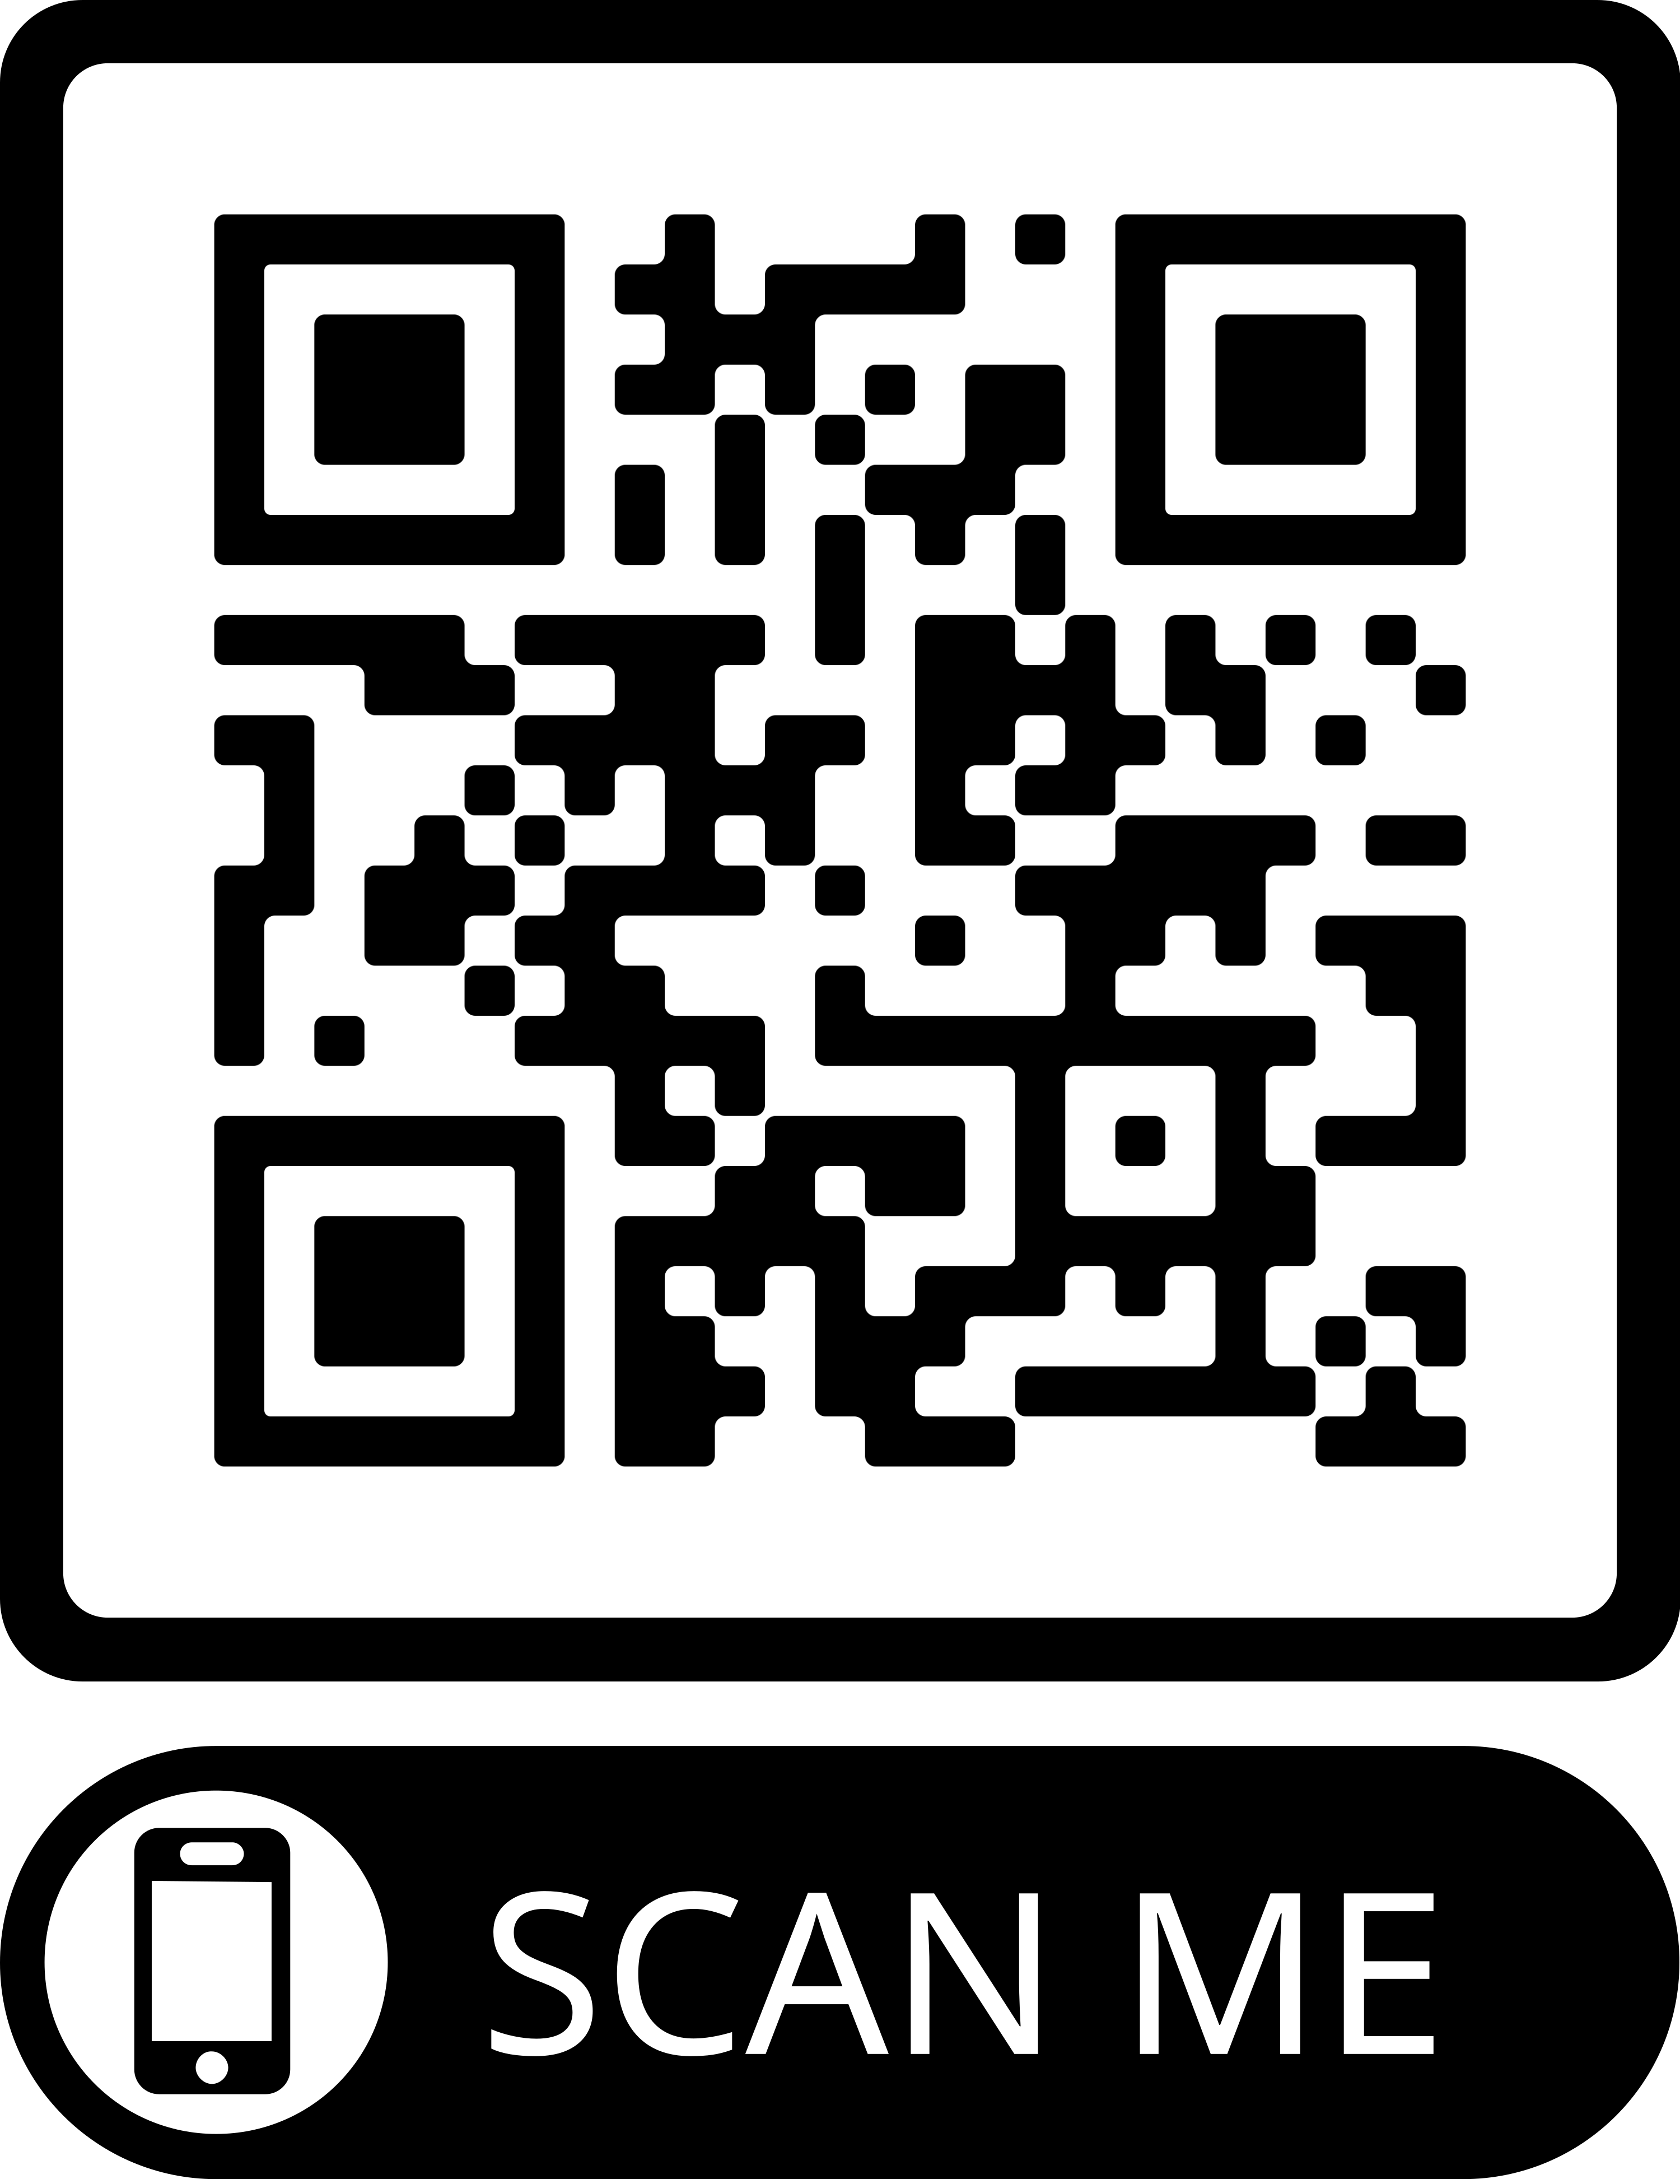
Link to the Material
The material of this tutorial can be found at https://shorturl.at/jLVZ7

Slide 4
Introduction to Declarative Process Mining
Notes:
There are two major approaches to Process Mining: imperative and declarative

Slide 5
Imperative approach
Process Domain
Imperative process models explicitly specify the allowed behaviour of the process at once.
Allowed behaviour
Notes:
With the imperative approach, the process model explicitly specify the allowed behaviour of the process at once.
A process model in these sense could be a BPMN, or a Petri Net

Slide 6
Declarative approach
Process Domain
Declarative process models implicitly specify the allowed behaviour of the process through a set of constraints.
(Everything that is not forbidden is allowed)
Constraint 1
Constraint 2
Forbidden behaviour
Notes:
The declarative approach instead implicitly specify the allowed behaviour through a set of constraints, that describes the forbidden behaviour instead of the allowed one.
In few words: everything that is not forbidden is allowed.
The process model results to be the set of so defined constraints

Slide 7
Declarative approach → Declare
Declare uses specific LTL_{f} formulas over “activities” for constraint definition
Process Domain
Declarative process models implicitly specify the allowed behaviour of the process through a set of constraints.
(Everything that is not forbidden is allowed)
Constraint 1
Constraint 2
Forbidden behaviour
Notes:
One of the most common declarative approaches is DECLARE.
DECLARE defines each constraint as a LTLf formula over the activities that can occur during the process

Slide 8
Some Declare constraints
Existence(A) LTL_{f} formalization: ◊A
Activity A occurs at least 1 time
in the process instance. BCAAC ✓ BCC ✗
Response(A, B)
LTL_{f} formalization: (A→◊B) If A (activation) occurs in the process
instance, then B (target) occurs after A. BCAAC ✗ CAACB ✓ CAC ✗ BCC ✓
Absence(C)
LTL_{f} formalization: ￢◊C
Activity C does not occur in the
process instance.
BAA ✓ BACA ✗
Chain Response(A, B)
LTL_{f} formalization: ☐(A → OB) Each time A occurs in the process instance, then B occurs immediately afterwards.
BCAAC ✗ BCAABC ✗ BCABABC ✓
Notes:
These are few examples of DECLARE constraints.
Even if several constraints have been implemented, the Response constraint is the one we will focus on throughout the presentation.

Slide 9
Some Declare constraints
Existence(A) LTL_{f} formalization: ◊A
Activity A occurs at least 1 time
in the process instance. BCAAC ✓ BCC ✗
Response(A, B)
LTL_{f} formalization: (A→◊B) If A (activation) occurs in the process
instance, then B (target) occurs after A. BCAAC ✗ CAACB ✓ CAC ✗ BCC ✓
Absence(C)
LTL_{f} formalization: ￢◊C
Activity C does not occur in the
process instance.
BAA ✓ BACA ✗
Chain Response(A, B)
LTL_{f} formalization: ☐(A → OB) Each time A occurs in the process instance, then B occurs immediately afterwards.
BCAAC ✗ BCAABC ✗ BCABABC ✓
Notes:
Response is a binary constraint, as it involves two activities. It states that if activity A occurs in the process instance, then the activity B should occur after A.

Slide 10
DataLane interest in Declarative PM
A simple use case
Notes:
Hi everyone, I’m Francesco Riva, I work in DataLane and today I will explain you why Declarative Process Mining is being considered more and more in the business companies, and consequently why DataLane is so interested in it.
I’m going to start with a simple use case called Maverick Buying

Slide 11
Use case: Maverick Buying in P2P
Procure-to-Pay (P2P) is the process to purchase goods and services by negotiating an agreement with the vendors
P2P start
Procurement
Accounts Payable
Create Purchase Requisition (PR)
Receive Invoice
Create Purchase Order (PO)
Post Invoice
P2P end
Send PO to Vendor
Clear Invoice
PO Confirmation
Receive Goods
Notes:
Maverick Buying happens within the Procure-to-Pay process, that is the process to purchase goods and services by negotiating an agreement with the vendors. It is composed by two subprocesses: Procurement and Accounts Payable. In the picture you can see a simplified flow of the most important activities happening in the P2P process, but please note that in real companies the process can be much more complex than that.
The P2P starts with the Procurement subprocess, that comprehends the creation of Purchase Requisition and Purchase Order, then the PO is sent to the vendor to start the negotiation of prices and quantities, and after the negotiation the PO is confirmed. After some time, our organization will receive the goods we requested from the vendor, together with the invoice. Here the Accounts Payable subprocess starts, dealing with the accountability of received goods, so that the invoice is posted and then cleared.
Now that we know how a P2P should behave, let’s introduce Maverick Buying, an undesired deviation from the general process flow.

Slide 12
Use case: Maverick Buying in P2P
Maverick Buying describes a purchase of goods starting from outside the Procurement (sub)process
Absence of logging info
No negotiation of agreement
Procurement
Accounts Payable
Create Purchase Requisition (PR)
Maverick Buying
start
Receive Invoice
Create Purchase Order (PO)
Post Invoice
Send PO to Vendor
Maverick Buying
end
Clear Invoice
PO Confirmation
Receive Goods
Notes:
Maverick Buying describes a purchase of goods that starts from outside the Procurement subprocess.
For example, let’s say that our company is suddenly running low on a critical material, so that we’re in a hurry to procure more of it. We couldn’t wait to the whole Procurement process to take place, so that one of our employee directly contacts the vendor (for example, by a phone call) to procure that specific material. The agreement is done during the phone call and the vendor directly send us the invoice (the Receive Invoice activity takes place) then our employee creates a fake Purchase Order to start the Procurement process afterwards. Please note how the P2P process has now started from outside the Procurement, in fact the first activity is an Accounts Payable activity.
After some time, we will receive the goods we wanted, and the invoicing process can then end, with posting and clearing of the invoice we received at the very beginning.
Note that this is just one of the flows that a Maverick Buying can have, it can sometimes happen that neither the Create Purchase Order nor the Receive Goods activities are logged, so that just the invoicing process to an inexistent order is visible to the management. Another drawback is that the order doesn’t follow the standard negotiation flow (with PO Confirmation activity), this can result to worse purchasing conditions, leading to cash loss.
In the end, as you may understand, the Maverick Buying reflects a procurement of goods that is poorly planned from our company. This is definitely something that should be tracked and, in some extent, prevented.

Slide 13
Use case: Maverick Buying in P2P
Maverick Buying describes a purchase of goods starting from outside the Procurement (sub)process
Absence of logging info
No negotiation of agreement
Procurement
Accounts Payable
Create Purchase Requisition (PR)
Maverick Buying
start
Receive Invoice
Create Purchase Order (PO)
Post Invoice
Send PO to Vendor
Maverick Buying
end
Clear Invoice
PO Confirmation
Receive Goods
Notes:
As we can see from the picture, the flow denoting a Maverick Buying in the case I showed you is the one going backward from Accounts Payable subprocess to Procurement.

Slide 14
Use case: Maverick Buying in P2P
Receive Invoice
Create Purchase Order (PO)
Procurement
Accounts Payable
Create Purchase Requisition (PR)
Maverick Buying
start
Receive Invoice
Create Purchase Order (PO)
Post Invoice
Send PO to Vendor
Maverick Buying
end
Clear Invoice
PO Confirmation
Receive Goods
Notes:
Therefore, the flow from Receive Invoice to Create Purchase Order is the undesired flow with which we can identify the Maverick Buying.

Slide 15
Use case: Maverick Buying in P2P
Receive Invoice
Create Purchase Order (PO)
P2P start
Procurement
Accounts Payable
Create Purchase Requisition (PR)
Receive Invoice
Create Purchase Order (PO)
Post Invoice
P2P end
Send PO to Vendor
Clear Invoice
PO Confirmation
Receive Goods
Notes:
By doing one step back to the standard, desired flow of P2P process, we can see that here the desired flow is exactly the opposite.

Slide 16
Use case: Maverick Buying in P2P
Receive Invoice
Create Purchase Order (PO)
P2P start
Procurement
Accounts Payable
Create Purchase Requisition (PR)
Receive Invoice
Create Purchase Order (PO)
Post Invoice
P2P end
Send PO to Vendor
Clear Invoice
PO Confirmation
Receive Goods
Notes:
From Create Purchase Order, after some other activities, we should reach Receive Invoice.

Slide 17
Use case: Maverick Buying in P2P
Receive Invoice
Create Purchase Order (PO)
Create Purchase Order (PO)
Receive Invoice
P2P start
Procurement
Accounts Payable
Create Purchase Requisition (PR)
Receive Invoice
Create Purchase Order (PO)
Post Invoice
P2P end
Send PO to Vendor
Clear Invoice
PO Confirmation
Receive Goods
Notes:
Now that we have designed which are the conditions identifying when a Maverick Buying happens or not. We are ready to see how to track this unwanted flow, and how to take actions to prevent it.

Slide 18
Where we are…
Conformance checking
Notes:
The most common way to check if a process conforms to a condition we defined, is called Conformance Checking.

Slide 19
Where we are… … imperative approach
Conformance checking with BPMN
Create Purchase Order (PO)
Receive Invoice
Notes:
It basically consists in comparing each process execution to a process model describing our condition, to check if the execution sticks to the conditions we defined in the model.
Nowadays, the way in which conformance checking is done is by following the imperative approach: a BPMN model is built that exactly shapes how the P2P process should behave from the first step to the last one, by also including the condition we want to comply with. In our case, the process model is a simple sequence of steps from the P2P start to its end.

Slide 20
Where we are… … imperative approach
Conformance checking with BPMN
Create Purchase Order (PO)
Receive Invoice
Nice! But what if…
Notes:
You would say: “Oh, that’s nice!”. But what happens if the process grows in complexity?

Slide 21
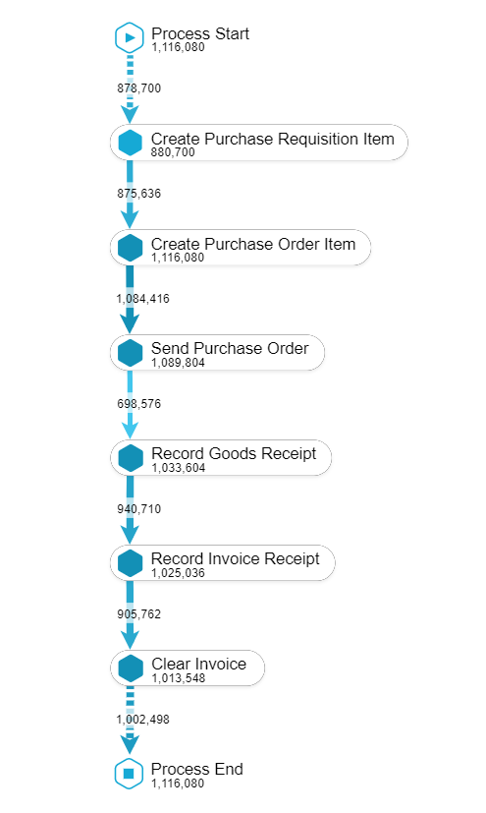
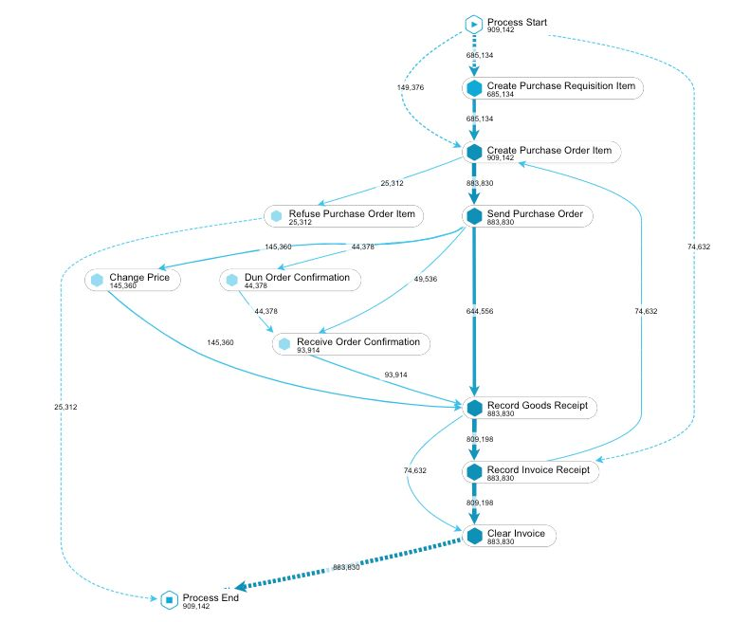
What if process grows in complexity?
Notes:
In the business companies, it’s unlikely that a process just follows a linear path to its end. Instead, many parallelisms and loops are possible among activities.

Slide 22
What if process grows in complexity?
Process model grows in complexity too!
Drawbacks of imperative approach
Knowledge of end-to-end process is required
Infeasible for (a bit more) complex processes
Difficult interpretation
Notes:
And what happens if we want to do Conformance Checking on such a complex process? The resulting BPMN model will grow in complexity too!
In general, some drawbacks for the imperative approach to Conformance Checking are:
that an end-to-end process knowledge is required. In the sense that you should know each activity of the process and list each single allowed parallelism and loop inside the process, so that you have to involve all the process stakeholders to design a process model.
And what if the process changes due to some new business criteria? There’s the chance that you could have to redesign the model almost from scratch;
This takes us to the second bullet point, it could be challenging, if not impossible, design models representing big and complex processes;
And what if I ask you to highlight the condition we embedded inside the model? It turns out that it’s difficult to interpret why the model was built for.
Moreover, the BPMN models are intended to shape the order in which activities should be executed within a process, telling us nothing about their payload. For example, a PO Creation activity will carry information about the quantity or the price of the requested goods, but BPMN cannot embed this kind of information in it.

Slide 23
What we want
Focus on what matters (no E2E knowledge required)
Clear definition on what is allowed and what is not in a process execution
Robust to process change
Check multi-dimensional conditions (timestamps, users…)
Notes:
Given that, we can resume what we are searching for:
A technique that focuses on the desired conditions instead of listing all possible execution flows
A technique that is resilient to process changes, in such a way that you shouldn’t redesign the whole model to meet a single change in business criteria of the company
A technique that allows us to check also conditions over payloads along with the related activities (such as conditions on execution times and the user that executed a certain activity)

Slide 24
How we can have it… … declarative approach!
Conformance checking with DECLARE
Create Purchase Order (PO)
Receive Invoice
Response(A, B) If A occurs in the process instance, then B occurs after A.
Notes:
All of these things are possible by using the declarative approach! In particular, with the DECLARE language for process models, we can simply encode conditions basing on pre-defined templates covering a wide range of business conditions. In our case, the condition between Create Purchase Order and Receive Invoice is matched by the Response template, for which: “If Create PO occurs in the process instance, then Receive Invoice occurs after Create PO”. No need to list all of the possible paths of our process flow!

Slide 25
What we want
Focus on what matters (no E2E knowledge required)
Clear definition on what is allowed and what is not in a process execution
Robust to process change
Check multi-dimensional conditions (timestamps, users…)
Notes:
The Declarative Conformance Checking answers to some of our needs:
It focuses on what matters since the rule to check is just the one corresponding to the involved activities. We don’t have to know how the process behaves in other cases. Moreover, the model is easier to interpret since the Response condition already describes what we desire in our process;
It is resilient to process changes, since the declarative model with the Response condition will still hold if the desired process flow changes in some part we don’t really care

Slide 26
What we want
Focus on what matters (no E2E knowledge required)
Clear definition on what is allowed and what is not in a process execution
Robust to process change
Check multi-dimensional conditions (timestamps, users…)
Notes:
In order to check multi-dimensional conditions, an extension to the DECLARE standard, called Multi-Perspective DECLARE is already available, it takes into account of the payload of activities involved in the conditions.

Slide 27
What we want
Focus on what matters (no E2E knowledge required)
Clear definition on what is allowed and what is not in a process execution
Robust to process change
Check multi-dimensional conditions (timestamps, users…)
with Multi-Perspective DECLARE!
Notes:
In order to check multi-dimensional conditions, an extension to the DECLARE standard, called Multi-Perspective DECLARE, is already available. It can take into account of the payload of activities involved in the conditions.
So that I already showed you how with the declarative approach we can overcome the drawbacks of the imperative approach, but we can even do something more.

Slide 28
Query Checking A new way to analyse processes
Conformance Checking
Query Checking
Process model
Existence(Create PO) | user = “RIVA”
Response(Create PO, Receive Invoice)
Process model
Existence(Create PO) | user = ?
Response(Create PO, ? )
Conformance checking output
Query checking output
Execution 1 Conformant
Execution 2 Conformant
Execution 3 Non-conformant
…
Existence(Create PO) | user = “RIVA” or “MAGGI”
Response(Create PO, Receive Invoice)
Response(Create PO, Clear Invoice)
…
Notes:
What I will show here is a new way to analyse processes by leveraging another declarative approach to Process Mining that is valuable to our business use case.
It is called Query Checking and is different Conformance Checking.
While Conformance Checking aims to check if process executions are conformant to a defined process model, Query Checking instead can further discover new conditions over a partially defined process model.
In the slide you can see highlighted on the left a process model with a condition defined over the payload of an activity, that means that the activity Create PO should exist in the process execution when executed by user with name “RIVA”.

Slide 29
Query Checking A new way to analyse processes
Query checking with (Multi-Perspective) DECLARE
Notes:
What I will show you now is a new way to analyse processes by leveraging another declarative technique that is valuable to our business use case.
Query Checking works somehow the opposite of Conformance Checking: instead of checking conditions against process executions as Conformance Checking, Query Checking instead can discover new insights on conditions that we provide as input.

Slide 30
Query Checking A new way to analyse processes
Query checking with (Multi-Perspective) DECLARE
Receive Invoice
Create Purchase Order (PO)
Response(A, B) If A occurs in the process instance, then B occurs after A.
Output
Notes:
Suppose that we are interested in the executions where the Maverick Buying occurs, that is, the ones where Receive Invoice occurs before than Create PO. Suppose now that we are interested in detail on what are the circumstances in which this peculiar flow happens.
We can basically query the payload with which the Response condition denoting Maverick Buying happens. Suppose the case in which the Receive Invoice has attached as payload the amount of the invoice, while the Create PO has attached the user that executed the activity.
The output of query checking will be the Response we queried, together with new information about the payload of the involved activities. So that now we know that Maverick Buying happened in our P2P process when the invoice amount was greater than 500$ and when the user that created PO was RIVA.
This could be a big value added when analysing business processes of our customers.

Slide 31
Why Declare4Py?
Declare4Py library implements DECLARE language
Easy-to-use APIs
Already provides the functionalities we desire out-of-the-box:
Conformance checking
Discovery
Query checking (no other tools implement it)
And much more!
Notes:
All of this brings to Declare4Py. We are interested in it because it implements the DECLARE language, also in the Multi-Perspective variant, and it has easy-to-use Python APIs.
Moreover, among all of the features it provides, there are also Conformance Checking and Query Checking that we discussed. Actually, it is currently the only tool that implements Query Checking out-of-the-box. And it promises to do much more, so I leave the word to Ivan Donadello that will explain in detail what Declare4Py can do.

Slide 32
Declare4Py overview

Slide 33
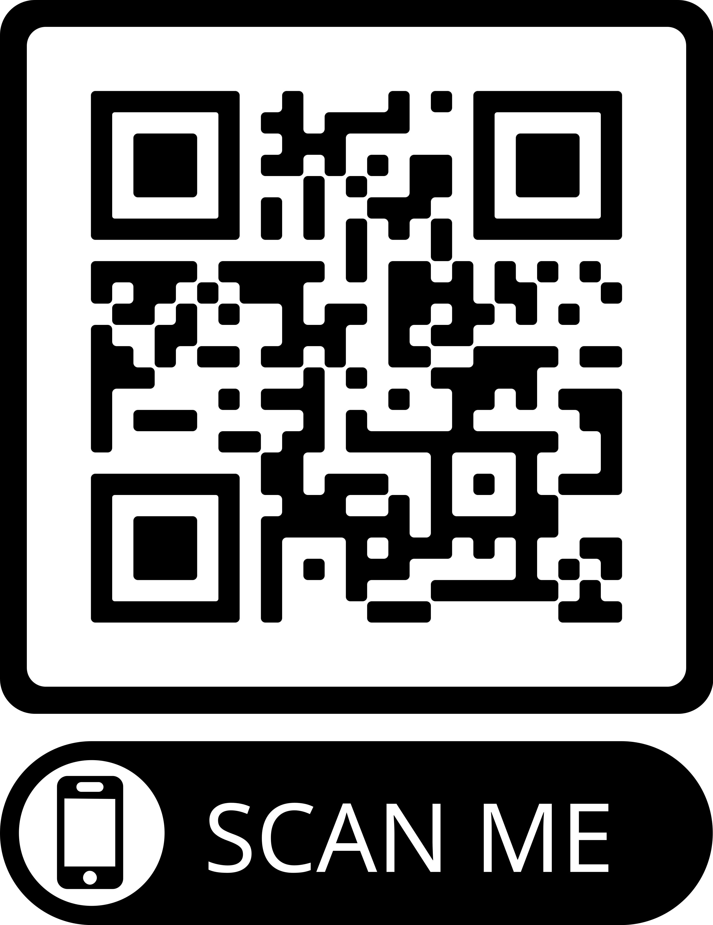
What is Declare4Py?
A Python library that supports Declarative Process Mining tasks
https://github.com/ivanDonadello/Declare4Py

Slide 34
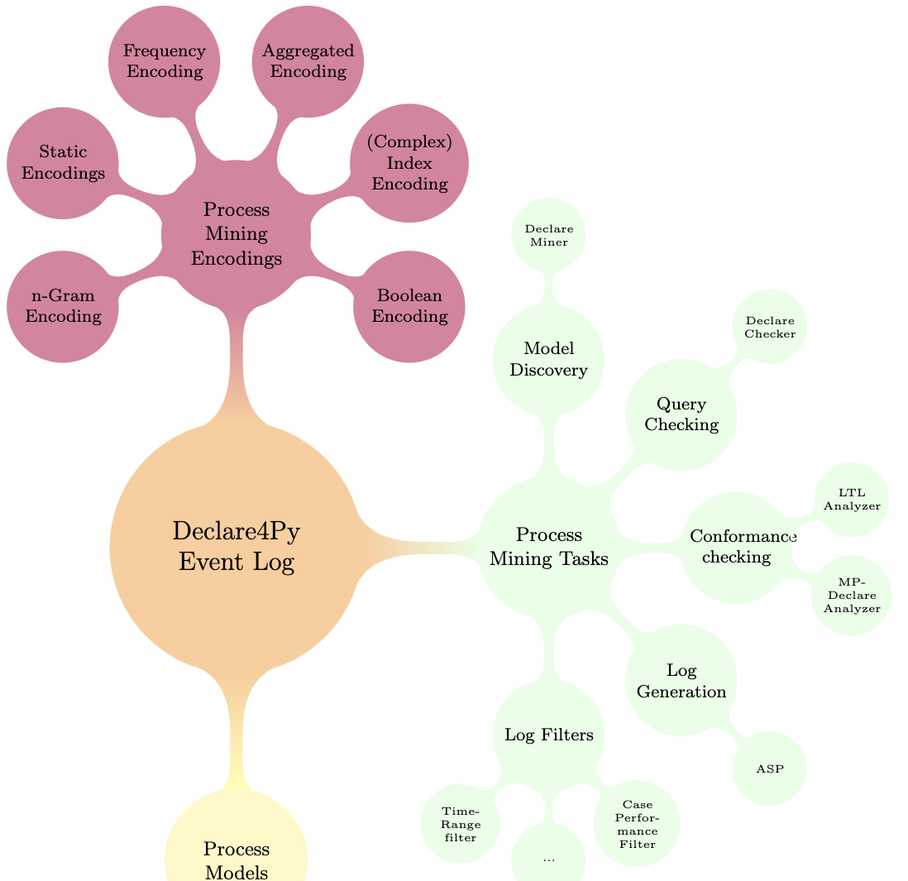
What is Declare4Py?
Main concepts
Event Log
Process Model
Process Mining Tasks:
Conformance checking
Model discovery
...
Support for
log encoding (for ML tasks)
Log filtering

Slide 35
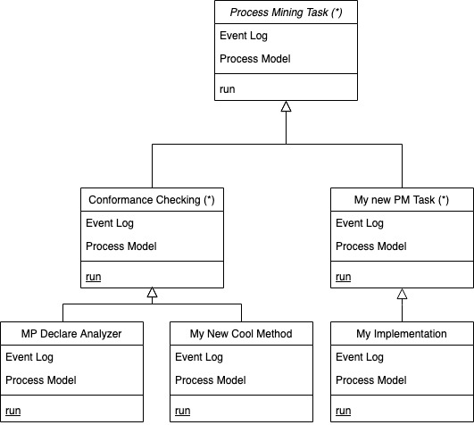
What is Declare4Py?
Is an easy extendable library for:
new Process Mining tasks
new implementations of the already defined Process Mining tasks
You just need to extend the existing abstract classes

Slide 36
Declare4Py in action

Slide 37
Declare4Py in Action (Support for)
Event logs
Basic log operations (e.g., load and save xes, extract traces/payloads)
Log filtering
Log encoding for ML applications
Process Models
Declarative (MP-Declare, LTLf)
Procedural (work in progress)
Process Mining tasks
Conformance Checking (for MP-Declare and LTLf models)
Query Checking (for MP-Declare models)
Model Discovery (for Declare models)
Log Generation (for MP-Declare models)

Slide 38
Declare4Py in Action
Live code session

Slide 39
Declare4Py in Action (Application in a Project)
Declare4Py will be used in the ReSS-Pro national project: Recommender Systems for Sustainable Processes
Objective: Prescriptive Process Monitoring for triggering interventions for positive process outcome and minimizing natural resources.
E.g., Declare-based encoding; recommendations expressed with Declare constraints.
Collaboration between Unibz and Datalane.
Starting in January 2024, two years.
Looking for PostDocs! See the call at https://ivandonadello.github.io/

Slide 40
Declare4Py in Action (ICPM Demos)
Come and see our demo papers:
Two Solutions for Checking LTLf Properties in Event Logs
ASP-Based Log Generation with Purposes in Declare4Py

Slide 41
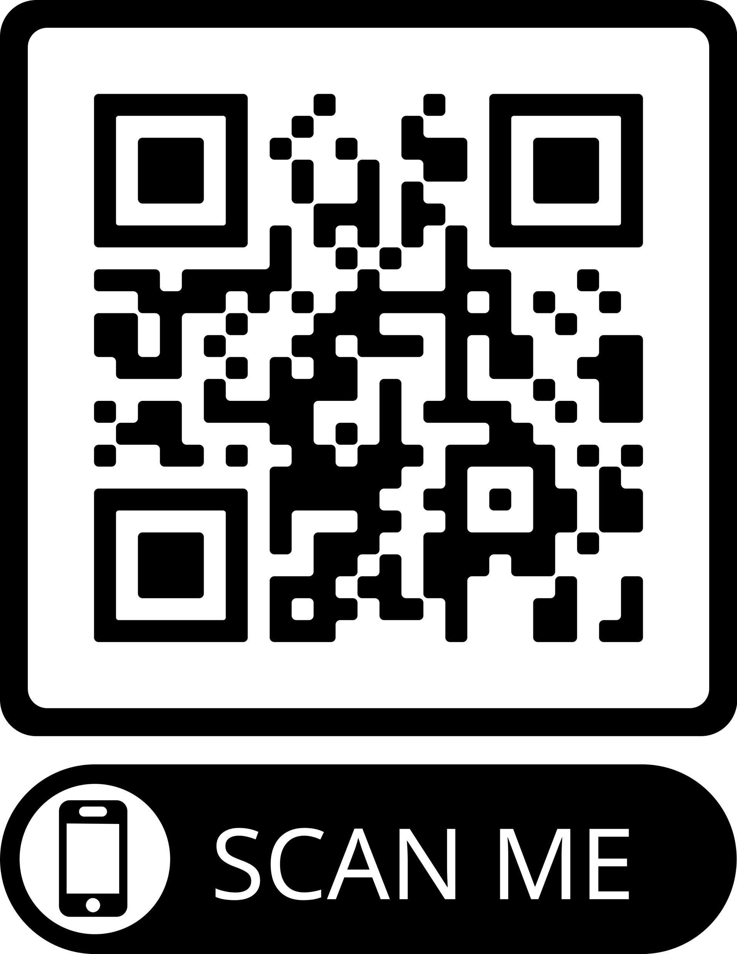
Thank you Questions?
Tutorial Material
Declare4Py
Call to the PostDoc position

